Slide 1
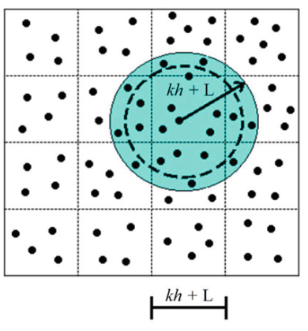
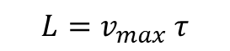
Further improvement: Verlet algorithm
Neighbourhood particles computed once every n steps using their maximum possible displacement.
$$L=v_{max} τ$$

Slide 2
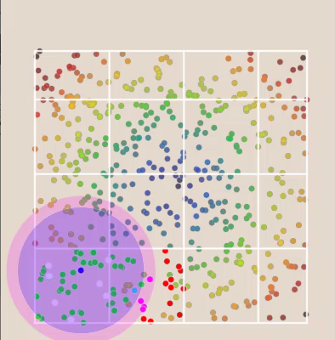

Slide 3
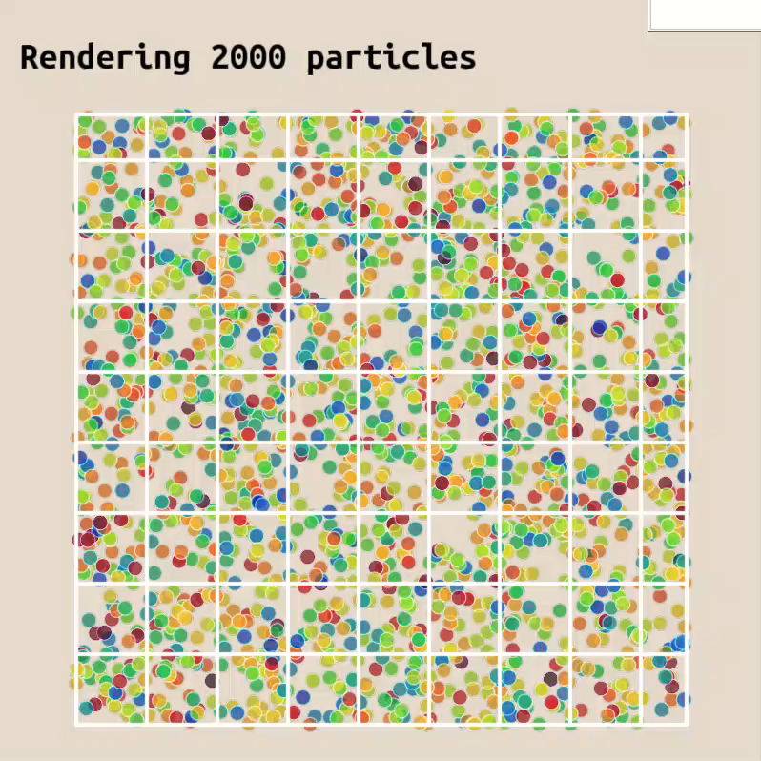
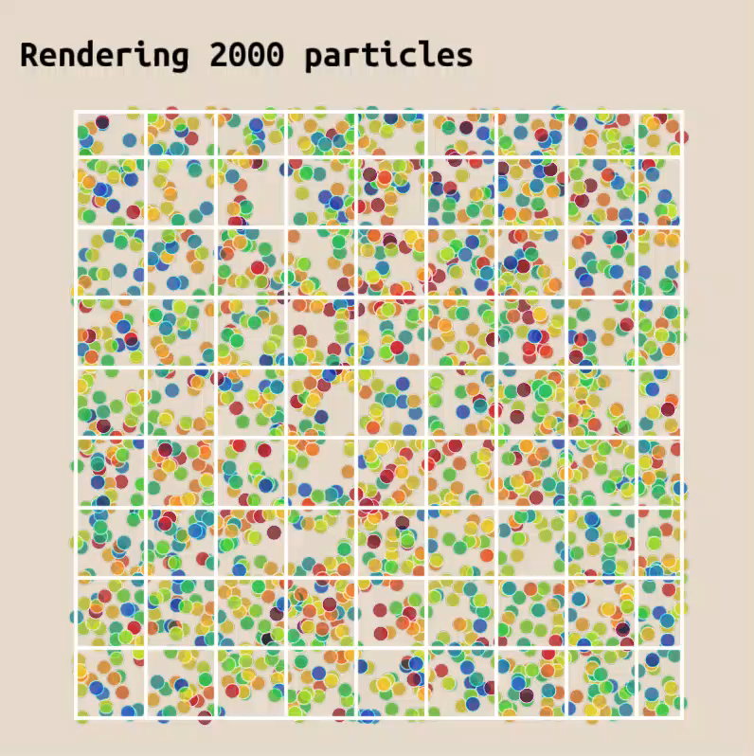
Without neighbouring search
With neighbouring search

Slide 4
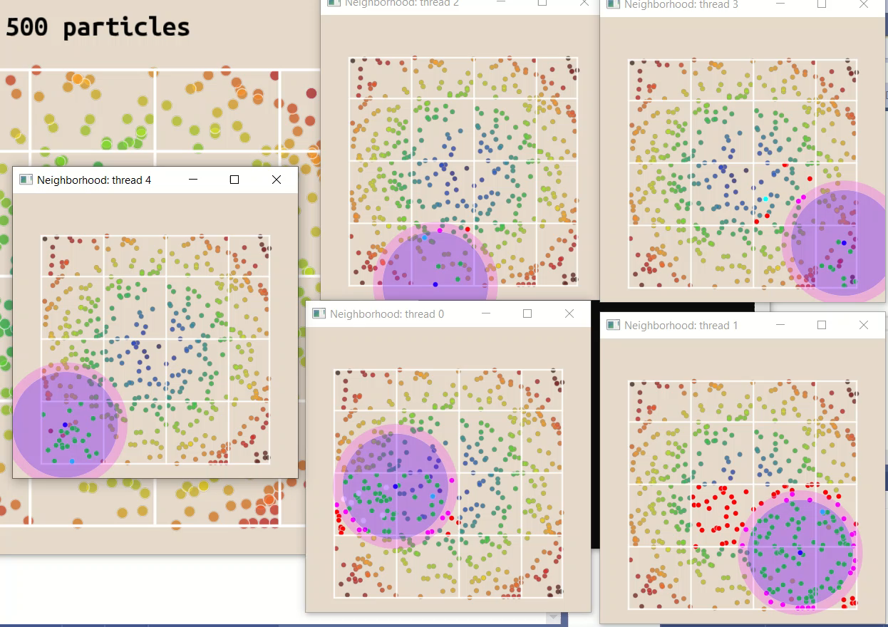

Slide 5
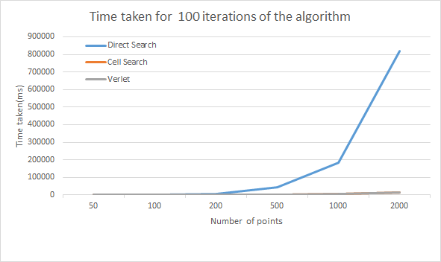
Performance analyses

Slide 6
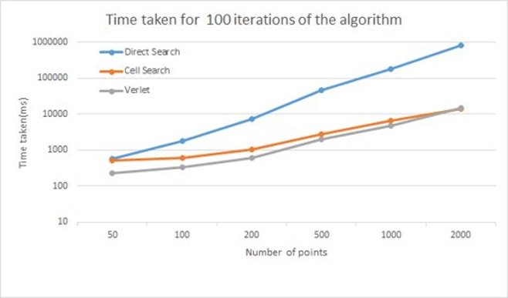
Performance analyses

Slide 7
Thank you for your attention

